Slide 1
The influence of the Dutch weather on the health of horses
Faculty of electrical engineering, mathematics and Computer science
Data management & biometrics
Josje van ‘t Padje
Notes:
Thank you mannes for the INTRODUCTION
Good morning everyone, welcome to my presentation and off course a HAPPY NEW YEAR

Slide 2
Motivation & background
Research Questions
Methodology& Results
Conclusion
Questions
Notes:
start with motivation and background
followed research questions
Then methods and the results
Conclusion = answer the RQs
Afterwards questions

Slide 3
Motivation & Background
1.
Motivation & Background
Research Questions
Methodology & Results
Conclusion
Questions

Slide 4
Assumptions
High amounts of wind causes colic
High humidity causes respiratory problems
High humidity causes fungal infections on the skin
Muddy pastures cause mud fever
High sugar in grass, due to cold nights, causes laminitis
Motivation & Background
Research Questions
Methodology & Results
Conclusion
Questions
Notes:
HORSE OWNERS
EQUINE PROFESSIONALS
ASSUMPTIONS
CAUSES of diseases
assumptions CLAIM specific weather conditions PARTICULAR diseases.
For example -> see screen
GOAL determine true and false
help more ACCURATELY DIAGNOSE horses

Slide 5
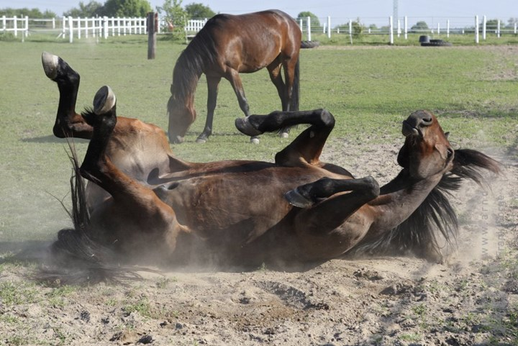
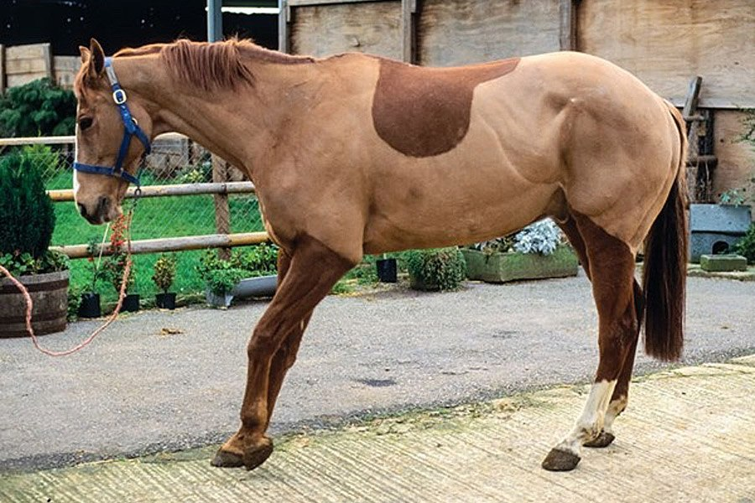
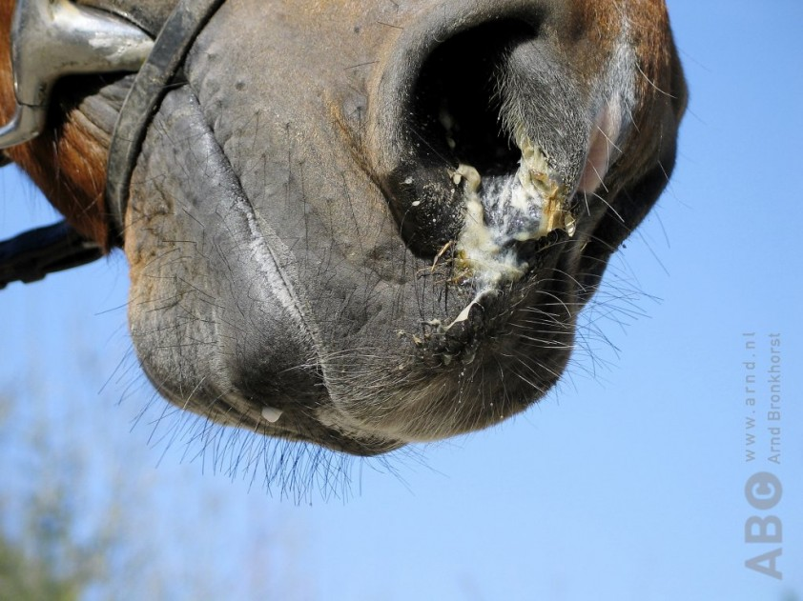
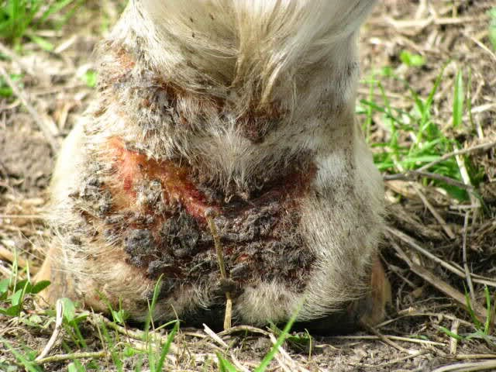
Diseases
Motivation & Background
Research Questions
Methodology & Results
Conclusion
Questions
Notes:
focusses on 4 diseases:
Colic abdominal pain
Laminitis INFLAMMATION
Respiratory any thing from snotty noses and coughing to NEUMONIA
Skin such as fungal and bacterial infections and ALLERGIC reactions. most common mud fever

Slide 6
Research questions
2.
Motivation & Background
Research Questions
Methodology & Results
Conclusion
Questions
Notes:
The research questions for this research are based on a LITERATURE REVIEW, done for this research on the RELATION between the four disease and the weather

Slide 7
First Research Question
What is the influence of the Dutch weather on the health of horses?
Does the temperature, barometric pressure and high amount of wind influence the occurrence of colic?
Is the development of laminitis dependent on stress in the grass, due to cold and drought?
Does hot, humid or cold weather worsen or induce respiratory disease?
Do skin diseases occur more in periods of heavy rainfall and high humidity?
Motivation & Background
Research Questions
Methodology & Results
Conclusion
Questions
Notes:
The first question is …
divided into 4 sub questions:
…

Slide 8
Second Research Question
To what extent can the Dutch weather be used to predict the occurrence of ...
… colic ?
… laminitis?
… respiratory disease?
… skin disease?
Motivation & Background
Research Questions
Methodology & Results
Conclusion
Questions
Notes:
The second research question is ….

Slide 9
Methodology & results
3.
Motivation & Background
Research Questions
Methodology & Results
Conclusion
Questions

Slide 10
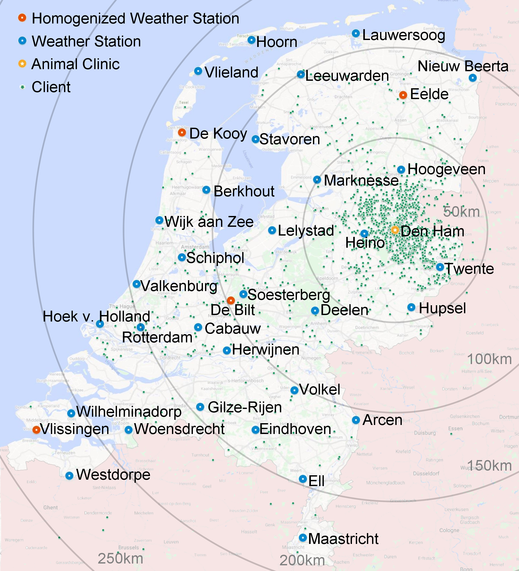
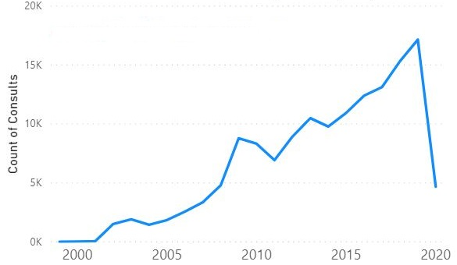
Data
144.400 lines in total
58.927 consults over 21 years
Motivation & Background
Research Questions
Methodology & Results
Conclusion
Questions
Notes:
two datasets are MERGED:
ANIMAL CLINIC DEN HAM and weather data.
KNMI dataset of weather station Heino
Heino closest to den ham.
weather data one row for each day in the dataset.
weather data 34 weather variables
Like daily main wind speed, maximum wind speed and the hour in which this maximum is measured.
7 categories: WIND, TEMPERATURE, SUNSHINE DURATION, PRECIPITATION, BAROMETRIC PRESSURE, HUMIDITY AND EVAPORATION.
Weather data range: 13 November 98 till 9 April 2020
Vet data: 20 January 99 and ends on 9 April 2020 again.
144 thousand lines in vet data
THINGS LIKE the horse, the owner, the veterinarian in CHARGE and an EXPLANATORY TEST OR THE MEDICATION or treatment GIVEN.
Same horse same day = consult
60 thousand consults in 21 years .

Slide 11
Labelling Consults
Disease | Keyword(s) | # Consults (keyword) | # Consults (labelling) | Accuracy (keyword) | Accuracy (labelling)
Colic | Koliek | 765 | 4196 | 0.99557 | 0.98893
Laminitis | Hoefbevangen | 196 | 5037 | 0.99077 | 0.97509
Respiratory | Snot, Luchtweg, Bronchitis, Longontsteking | 273 | 2007 | 0.99336 | 0.98727
Skin | Schimmel, Mok | 638 | 18135 | 0.99520 | 0.84613
Motivation & Background
Research Questions
Methodology & Results
Conclusion
Questions
Notes:
DIAGNOSIS OR REASON
Keyword search
PROBLEMS:
false positive “this is not a case of …” or “the horse does not have a …”
false negative: no text, typos or spelling mistakes, use of other terms
Keyword count is low, CONFIRMED by veterinarian
10.000 consults labelled by hand.
binary labelling: 1 or 0 indicating weather or not horse is DIAGNOSED WITH THE DISEASE during the consult.
automatic labelling BAG of WORDS approach using stochastic gradient descent, with different classifiers and loss functions for the different diseases.
ML for labelling consults without text.
calculate accuracy keyword search and automatically labelled data.
Acc keyword probably less due to hand labelling of text consults mainly

Slide 12
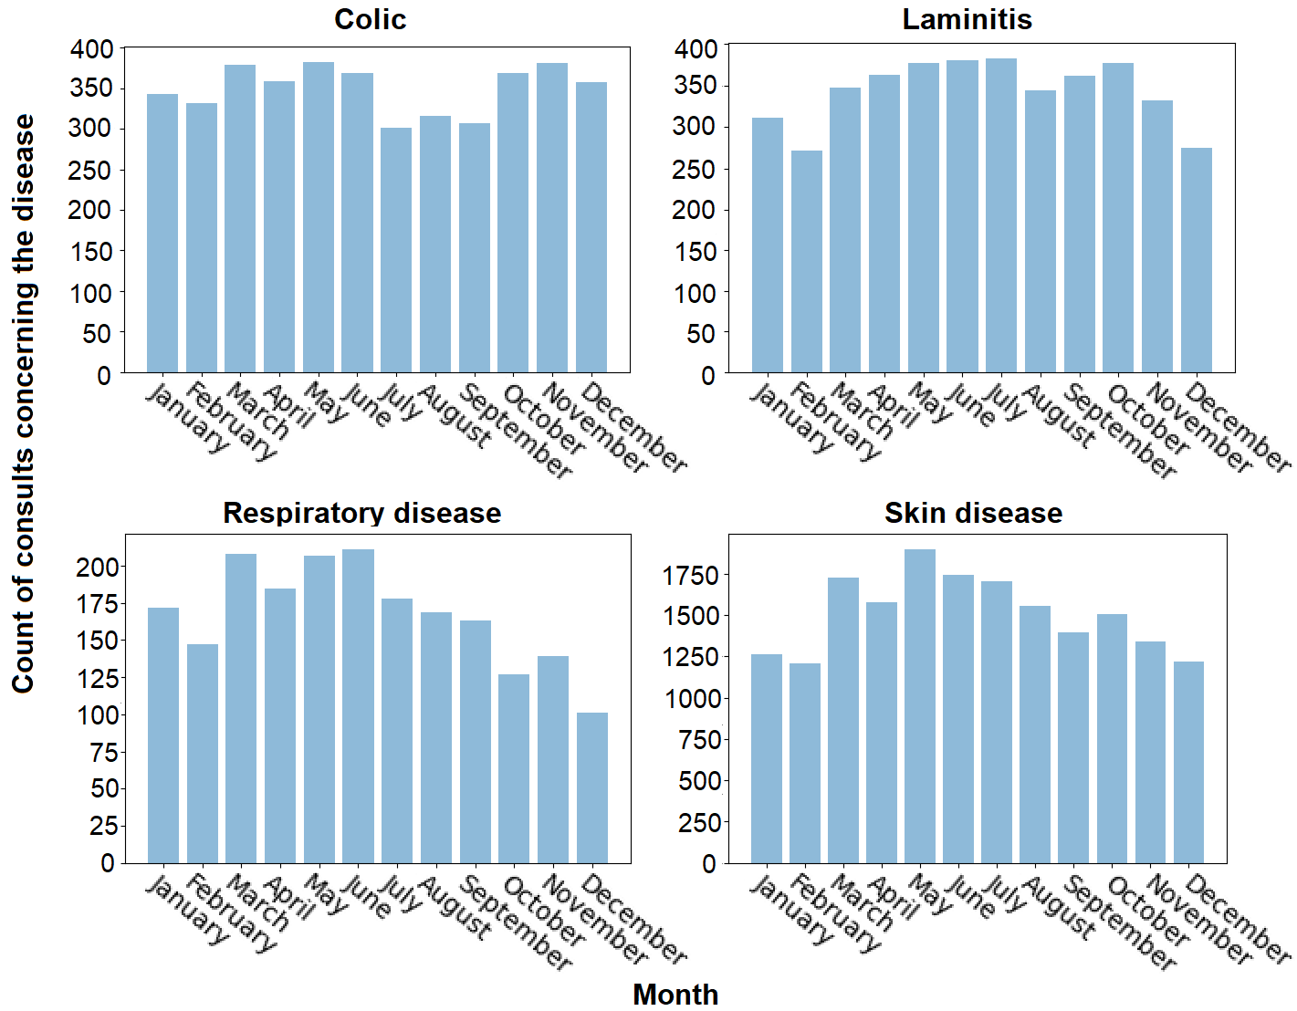
visualization
Motivation & Background
Research Questions
Methodology & Results
Conclusion
Questions
Notes:
More insight:
Colic: as expected by LITERATURE and vet
Laminitis: first peek expected overload of grass, second peek vet: horses on grass later in the year
Respiratory: expected more during fall, vet: probably due to SUSCEPTIBLE foals
Skin: expected more during fall, no explanation, CHANGES IN WEATHER, not visualized

Slide 13
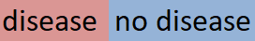
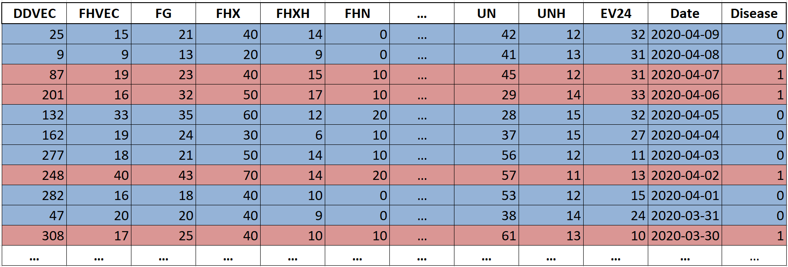
visualization
Motivation & Background
Research Questions
Methodology & Results
Conclusion
Questions
Notes:
SPLIT weather data for visualizations and correlations
Example for how to split.
Days when disease is seen in one
Remaining days in the other
Dt-1 colour down or data up

Slide 14
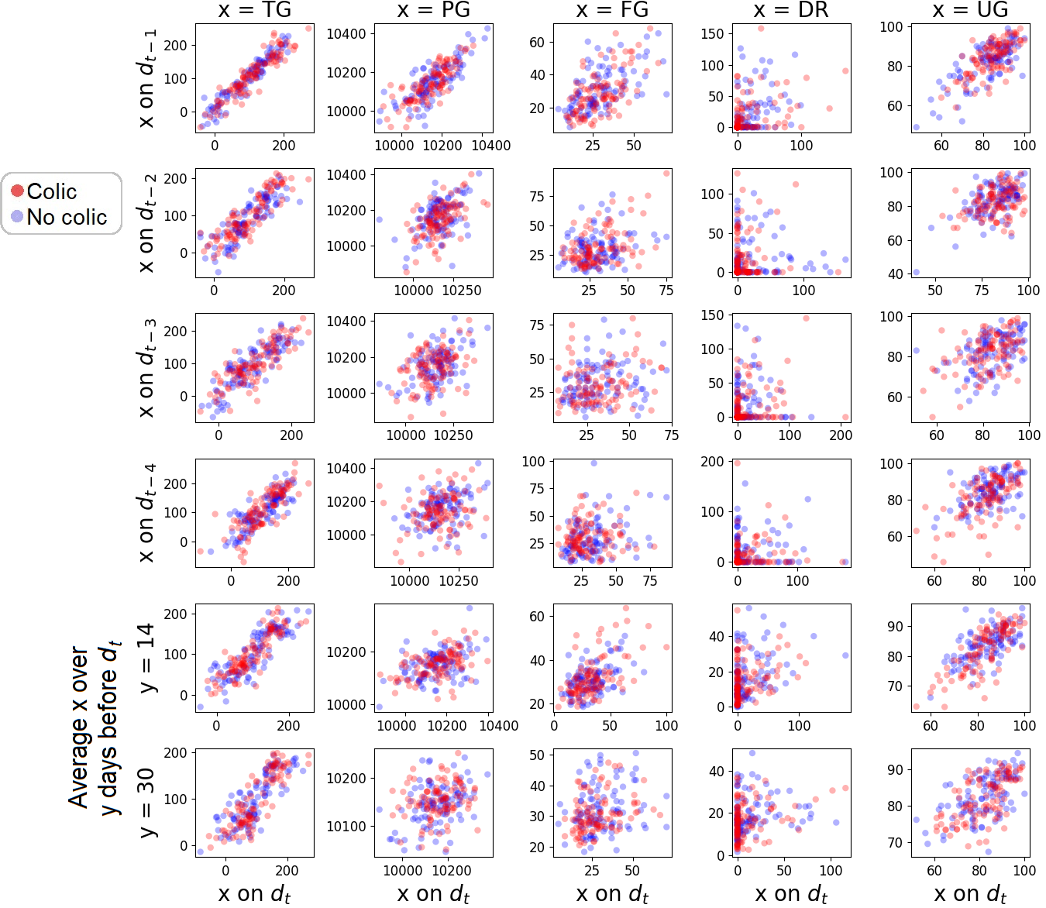
visualization
Motivation & Background
Research Questions
Methodology & Results
Conclusion
Questions
Notes:
To find obvious correlations between Changes in weather and diseases
5 MOST MENTIONED: Daily Mean Temperature, Daily Mean Wind Speed, Daily Mean Barometric Pressure, Precipitation Duration and Daily Mean Relative Atmospheric Humidity.
Upper right or lower left.
Following same pattern: no obvious
Other 3 are very alike

Slide 15
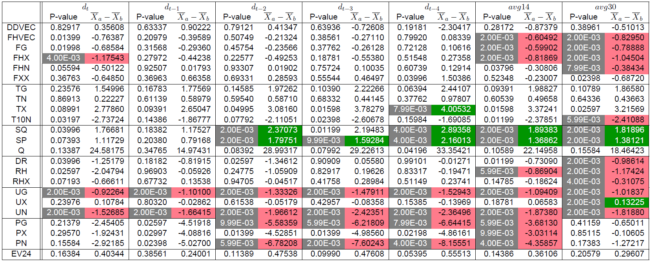
Correlations
Motivation & Background
Research Questions
Methodology & Results
Conclusion
Questions
Notes:
Same groups as visualizations
Permutation test = significance test:
p-value = probability difference occurred by chance
The gray cells = p-value < 0.01
0.01 = 1 % difference by change = 99% actual difference.
Red and green = negative and positive correlation
TX = maximum measured temperature on Dt-4 0.4 degrees higher during colic

Slide 16
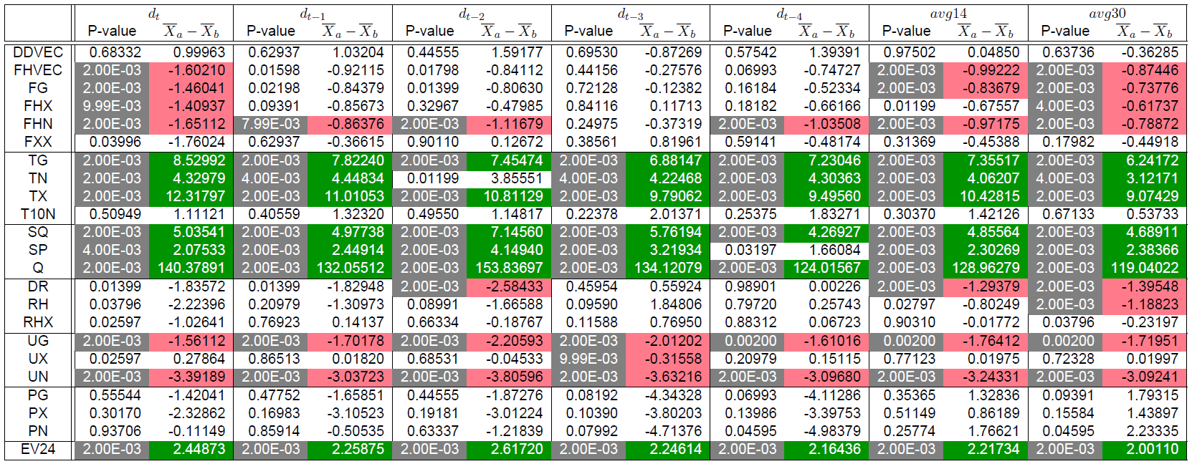
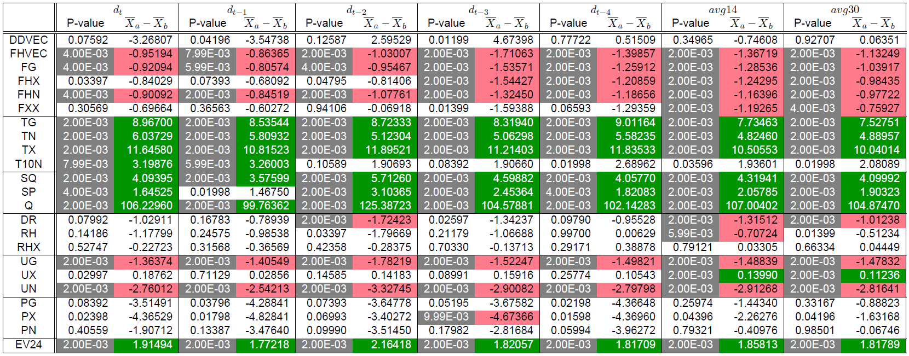
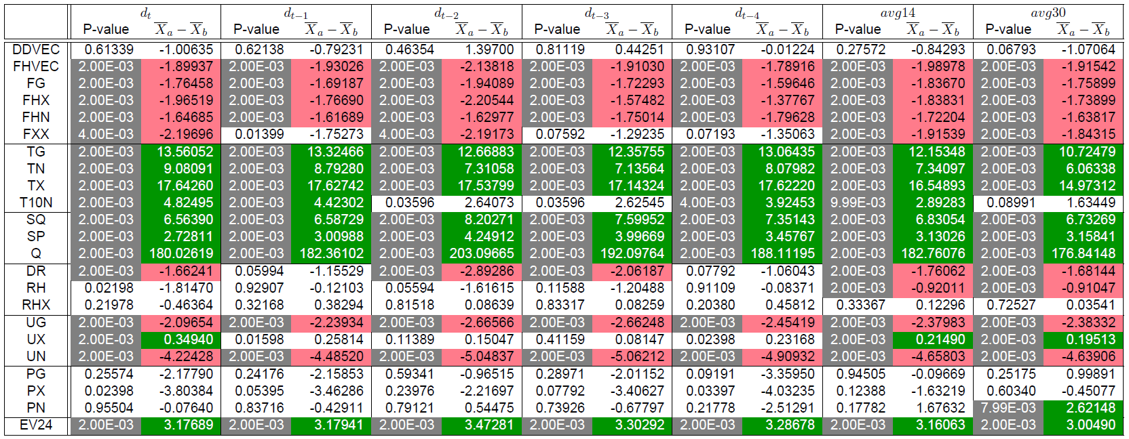
Correlations
Colic Laminitis
Respiratory disease Skin disease
Motivation & Background
Research Questions
Methodology & Results
Conclusion
Questions
Notes:
Small but colours!
Many correlations
Always positive or negative
Expected more specific weather conditions per disease, not bit of all

Slide 17
predictions
 | Single classifiers | Ensemble Predictions
 |  | Bagging | Boosting | Voting
Linear Regression
Support Vector Machine
Decision Tree
Neural Network
Motivation & Background
Research Questions
Methodology & Results
Conclusion
Questions
Notes:
literature ensemble predictions for weather data
tested 3 strategies:…
COMPARED to single classifiers.
Ensemble predictions combining one or more classifiers
Four classifiers …
work well with weather data and binary data
Single and bagging four times per disease
boosting algorithm only decision trees
voting algorithm combines classifiers into one model

Slide 18
predictions
 | Single classifiers | Ensemble Predictions
 |  | Bagging | Boosting | Voting
Colic | 0.67749 (LR) | 0.70102 (DT) | 0.69207 | 0.68338
Laminitis | 0.65162 (SVM, NN) | 0.64680 (DT) | 0.62583 | 0.63555
Respiratory | 0.79847 (SVM) | 0.79847 (SVM) | 0.79463 | 0.79847
Skin | 0.66803 (LR) | 0.74194 (DT) | 0.72225 | 0.66215
Motivation & Background
Research Questions
Methodology & Results
Conclusion
Questions
Notes:
Results
Single and bagging only best accuracy is shown
Not much difference between classification strategies

Slide 19
Conclusion
6.
Motivation & Background
Research Questions
Methodology & Results
Conclusion
Questions

Slide 20
Answer to First Research Question
What is the influence of the Dutch weather on the health of horses?
Does the temperature, barometric pressure and high amount of wind influence the occurrence of colic?
Is the development of laminitis dependent on stress in the grass, due to cold and drought?
Does hot, humid or cold weather worsen or induce respiratory disease?
Do skin diseases occur more in periods of heavy rainfall and high humidity?
Motivation & Background
Research Questions
Methodology & Results
Conclusion
Questions
Notes:
To answer question First sub questions

Slide 21
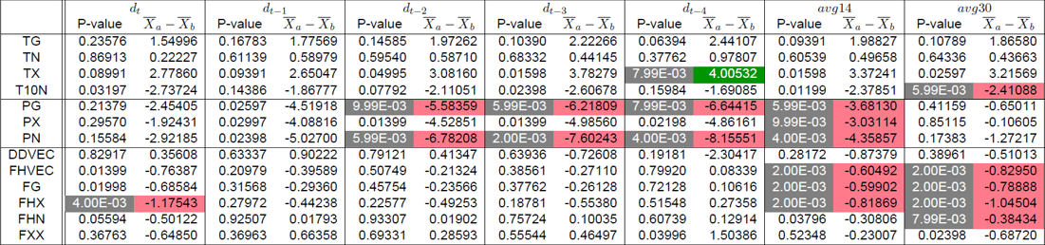
Answer to First Research Question
1. Does the temperature, barometric pressure and high amount of wind influence the occurrence of colic?
Motivation & Background
Research Questions
Methodology & Results
Conclusion
Questions
Notes:
All do correlate to weather conditions
Wind negativally
Barometric also negative, while literature mostly suggest positive

Slide 22
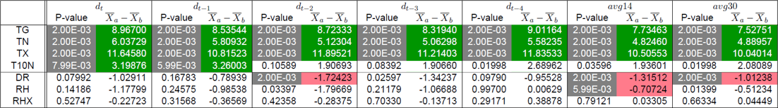
Answer to First Research Question
2. Is the development of laminitis dependent on stress in the grass, due to cold and drought?
Motivation & Background
Research Questions
Methodology & Results
Conclusion
Questions
Notes:
Temp positive instead of negative
Indeed less rain so drought
Weather conditions

Slide 23
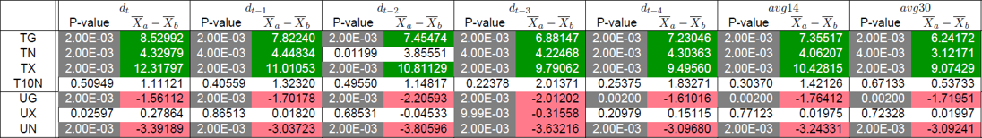
Answer to First Research Question
3. Does hot, humid or cold weather worsen or induce respiratory disease?
Motivation & Background
Research Questions
Methodology & Results
Conclusion
Questions
Notes:
Indeed high temperatures but not humid
Weather conditions

Slide 24
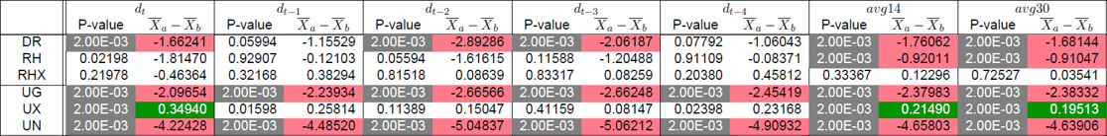
Answer to First Research Question
4. Do skin diseases occur more in periods of heavy rainfall and high humidity?
Motivation & Background
Research Questions
Methodology & Results
Conclusion
Questions
Notes:
Less rain
Low average humidity
But higher max
And lower min
Weather conditions

Slide 25
Answer to First Research Question
What is the influence of the Dutch weather on the health of horses?
Does the temperature, barometric pressure and high amount of wind influence the occurrence of colic?
Is the development of laminitis dependent on stress in the grass, due to cold and drought?
Does hot, humid or cold weather worsen or induce respiratory disease?
Do skin diseases occur more in periods of heavy rainfall and high humidity?
Motivation & Background
Research Questions
Methodology & Results
Conclusion
Questions
Notes:
lot of correlations
No correlations with specific diseases as expected
Weather conditions

Slide 26
Answer to Second Research Question
To what extent can the Dutch weather be used to predict the occurrence of ...
… colic ? 70.1% accurate
… laminitis? 65.2% accurate
… respiratory disease? 79.8% accurate
… skin disease? 74.2% accurate
Motivation & Background
Research Questions
Methodology & Results
Conclusion
Questions
Notes:
Respiratory most accurate almost 80% accuracy.
Laminitis hardest to predict 65%.
50% = randomness
prediction of the diseases is not very good.

Slide 27
Questions?
Motivation & Background
Research Questions
Methodology & Results
Conclusion
Questions
Notes:
Thank you
any questions?

Slide 28
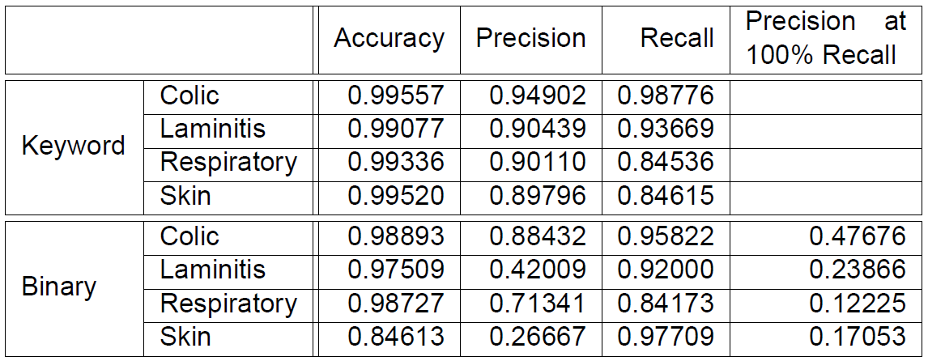
Questions
Motivation & Background
Research Questions
Methodology & Results
Conclusion
Questions

Slide 29
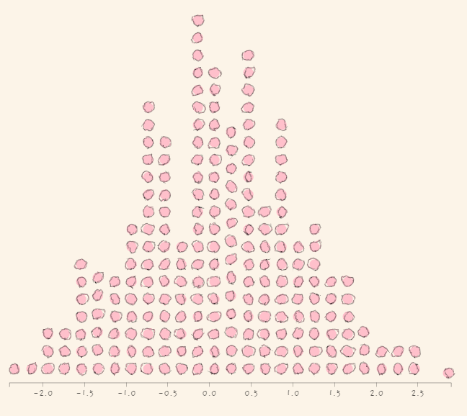
Questions
Motivation & Background
Research Questions
Methodology & Results
Conclusion
Questions
Notes:
As with the second visualizations, the weather data is split into groups A and B for the correlation analysis.
For the correlation analysis, I wanted to know if there is a significant difference between group A and group B or if this difference did occur by chance. For this, Permutation tests are used.
A permutation test works as follows:
The difference of the mean of the two groups is calculated. Then items in the groups are shuffled randomly and the difference in mean of these new groups is calculated again. This shuffling and calculation of the difference mean is done 1000 times.
When we would make a histogram of these plots we would get something like this. When the difference in mean of the actual group A and B is somewhere in the middle of this histogram, the probability that the difference in mean occurred by chance is quite large, while when this difference in mean is somewhere at the ends of the histogram this probability gets smaller. This probability is called the P_VALUE A permutation test is performed for each of the weather values, and diseases, to see which weather variables do have a correlation with the diseases

Slide 30
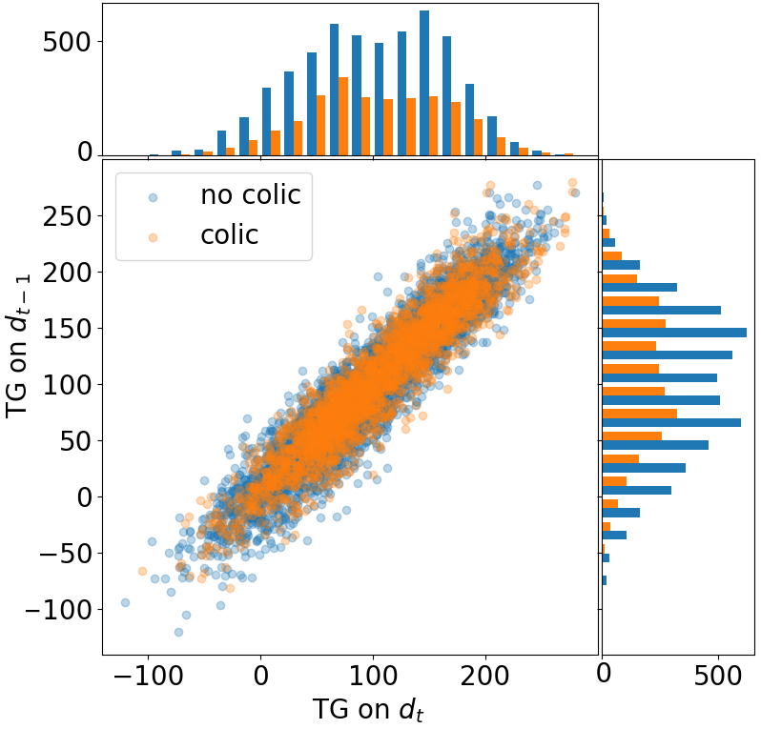
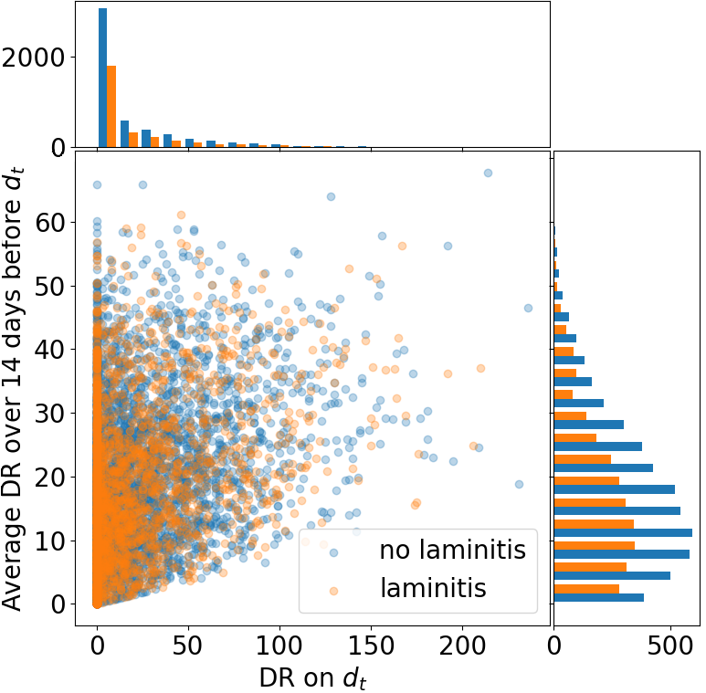
QUESTIONS
Motivation & Background
Research Questions
Methodology & Results
Conclusion
Questions
Notes:
Bigger, others have 100 dots
To make this even more clear I have made two of these visualizations bigger. These visualizations show the same data as the previous ones. There are a lot more dots in these visualizations as in the previous ones. That is because the previous plots only contain 100 dots per class for each of the images. That is done because, as we can see here, the second class completely overrides the first one, which makes it unclear what happens under need all these orange dots. Therefore the HISTOGRAMS are added at the sides of the plots. Since the histograms show the same shape for both classes, we can conclude that both classes are very similar.
And again, when changes in the weather would correlate to the disease we would expect the classes to have different shapes.

